Slide 1
Shower Control Box
The Cloud
Joystick
Messenger Service
Digital Display
Status LED
Humidity Sensor
Temperature Sensor
WiFi REST API
*x
Receive Box
Active Buzzer
Digital Display
Status LED
Water Sensor
Motor

Slide 2
Start
Decrease timer on display
Down
Joystick
Up
Increase timer on display
Enter
Control
box flowchart
Send message to all receiver nodes with selected time
Use API to query washing machine
Message API to Messenger
Use API to pause machine
Yes
Washing machine running?
No
Use API to query Dishwasher
Use API to pause machine
Yes
Dish
washer running?
No
Start timer countdown
Reset Timer
Yes
Timer finished?
No

Slide 3
Start (REST API received)
Receiver
Flowchart
Set the display to the time received by the request
Activate the buzzer for a short burst
Start the countdown timer
Turn LED on
Move motor to restrict water flow from tap
Wait 0.5 sec
Turn LED off
Buzzer
Yes
Water sensor wet?
Wait 0.5 sec
Timer finished?
No
No
Timer Finished?
Move motor to allow full water flow from tap
Stop
Yes

Slide 4
Before: Original Diagrams
After: Revised Diagrams

Slide 5
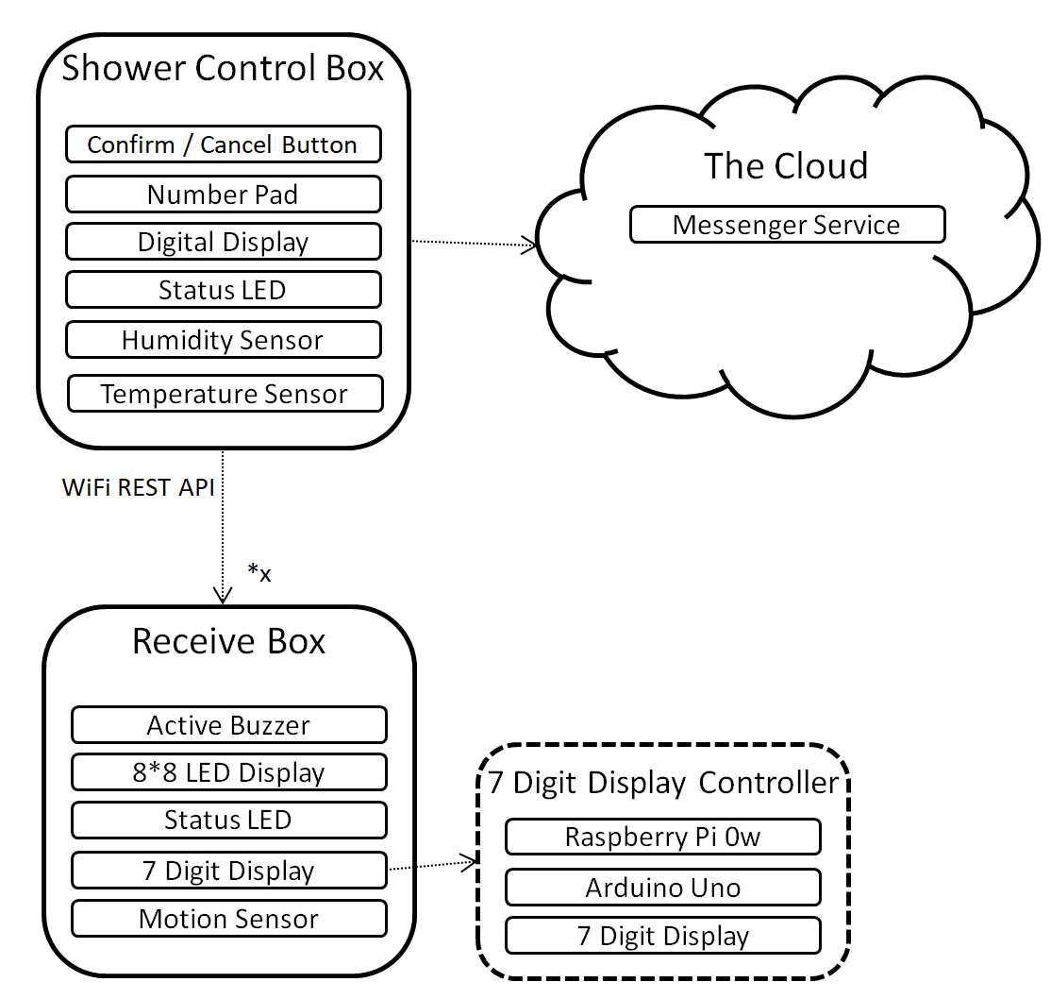
Shower Control Box
Confirm / Cancel Button
The Cloud
Number Pad
Messenger Service
Digital Display
Status LED
Humidity Sensor
Temperature Sensor
WiFi REST API
*x
Receive Box
Active Buzzer
7 Digit Display Controller
8*8 LED Display
Status LED
Raspberry Pi 0w
7 Digit Display
Arduino Uno
Motion Sensor
7 Digit Display

Slide 6

Control
box flowchart
Start
Append Number to display
Yes
Number Pressed?
Record temp and humidity
No
Assume shower started!
Yes
Spike in Temp or Humidity?
Remove last digit
Is there a number to remove?
Yes
Back
Button Pressed?
No
No
Set time to 15 mins
“Confirm” Button Pressed?
Yes
Flash LED to Acknowledge confirmation
Send message to all receiver nodes with selected time
Use API to query washing machine
Message API to Messenger
Use API to pause machine
Yes
Washing machine running?
No
Use API to query Dishwasher
Use API to pause machine
Yes
Dish
washer running?
No
Start timer countdown
Reset Timer
Yes
Timer finished?
No
Set timer to 0
Yes
“Confirm” button pressed?
Send “Cancel Shower” message to all receive nodes

Slide 7
Receiver
Flowchart
Start (REST API received)
Set display to show “Shower Running”
Wait until message finished displaying
Activate the buzzer for a short burst
Motion Detected?
Yes
Write “STOP” to screen
Start the countdown timer
Turn LED on
No
Yes
Buzzer
Yes
Motion Detected?
Wait 0.5 sec
Timer Finished?
Turn LED off
No
Wait 0.5 sec
Write “Shower Running” to screen
No
Timer Finished?
Timer finished?
No
Stop
Yes

Slide 8
Hazard | Risk | Likelihood | Prevention
Water Restriction | Emergency access to water restricted | Low | Water flow cannot be restricted at any time for any reason. In the event of a fire it would be harder to access water.
Electricity in bathroom | Electrocution | Very Low | Any electrical appliance in the bathroom should be low voltage and battery powered and well insulated
Flashing LEDs | Epileptic Seizure | Low | Warning to anyone who might use the system

Slide 9

Receive
Shower Blame™
No!
Still no!
Shower Blame™
Because it mildly annoys me
14:56
The system that will beep at you when I’m having a shower

Slide 10
Ingredients
1* RaspberryPi0W
1* LCD
1* Breadboard
1* Potentialom potenti potentiometer
1* LED
1*Temp + Humidity Sensor
1* Numerical Input pad
Blutak
Receive Ingredients
2* RaspberryPi0W
1* LED 8*8 Grid
2* Breadboard
1* Active Buzzer
1* LED
1* Motion Sensor
1* Arduino Uno
1* 3D printed holder
1* 7 Segment Display
1* So many cables

